Slide 1
Observability with Elastic
(Gergö
, Greg)
Gergely Kalapos
@gregkalapos
Elastic, Observability Team, .NET
Fake Austrian

Slide 2
Demo Application
Docker
Docker
DbService (.NET Core)
MySQL Db
Docker
Browser
Frontend (.NET Core)
fixer.io (http)

Slide 3
Demo

Slide 4
A system is observable when you can ask arbitrary questions about it and receive meaningful answers without having writing new code or command line tools.
It lets you discover unknown-unknowns and debug in production.

Slide 5
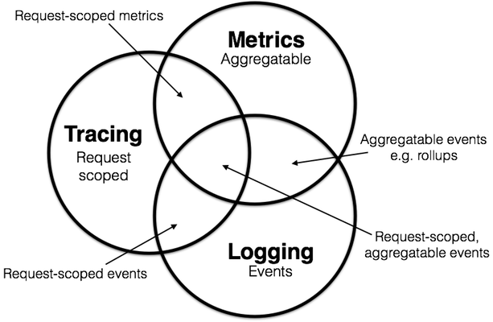

Why Elasticsearch?
Metrics
Search and Discovery
Correlation
Anomaly Detection
Alerting Dashboarding
Reporting
APM
Logs
Source : Peter Bourgon https://peter.bourgon.org/blog/2017/02/21/metrics-tracing-and-logging.html:

Slide 6

Observability is a search use case
Notes:
Talking points:
Elastic is a search company.
Search is omnipresent, and powers many experiences and use cases.
When people think of search, they think of a box. But, it’s so much more
The easiest way to explain this is through examples that you experience every day

Slide 7
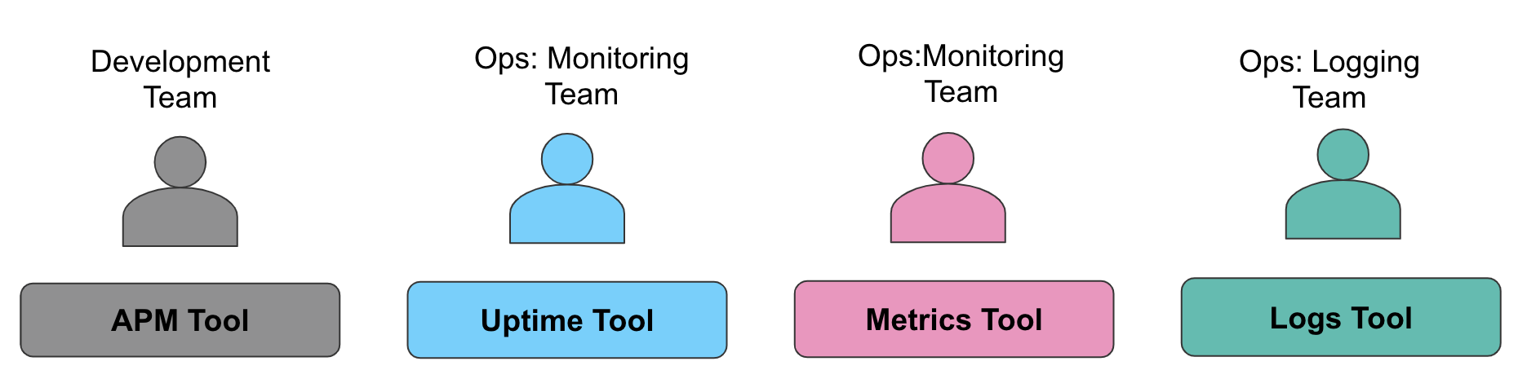
Status Quo : Siloed Collection of Tools
Real User Monitoring
Txn Perf Monitoring
Distributed Tracing
Uptime
Response Time
Container Metrics
Host Metrics
Database Metics
Network Metrics
Storage Metrics
Web Logs
App Logs
Database Logs
Container Logs

Slide 8
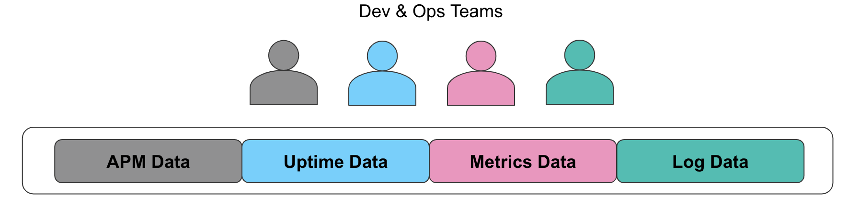


Elastic Approach to Observability
Real User Monitoring
Txn Perf Monitoring
Distributed Tracing
Uptime
Response Time
Container Metrics
Component Metrics
Host & Network Metrics
Database & Storage Metrics
Web Logs
App Logs / Database Logs
Container Logs
PaaS Component Logs
Kibana
Elasticsearch

Slide 9
3 Pillars of Observability

Slide 10
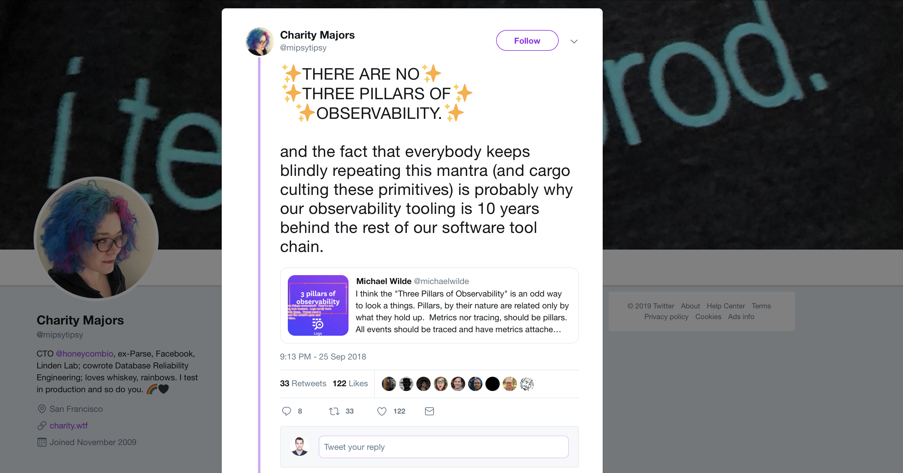
3 Pillars of Observability
Source: https://twitter.com/mipsytipsy/status/1044666259898593282?lang=en

Slide 11
Pillar or not, I honestly don’t care, just show me all logs and metrics to a specific trace!

Slide 12
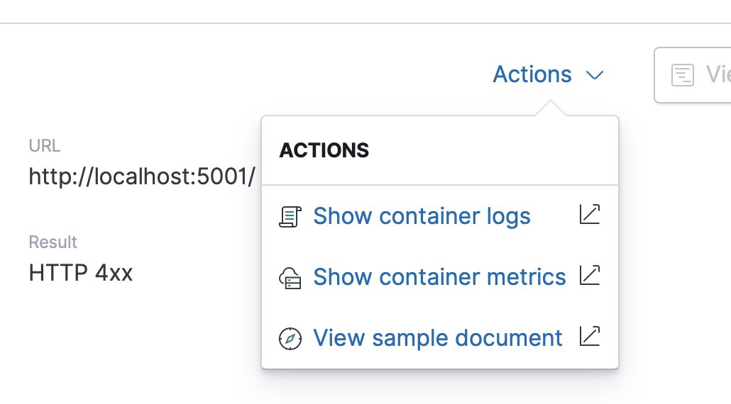
Elastic Common Schema (ECS) - Let’s correlate!
Provides a consistent and customizable way to structure your data in Elasticsearch
Dashboards and machine learning jobs can be applied more broadly
Searches can be crafted more narrowly
For observability: logs, metrics, and APM data have very similar format - it’s easy to jump from one to the other

Slide 13
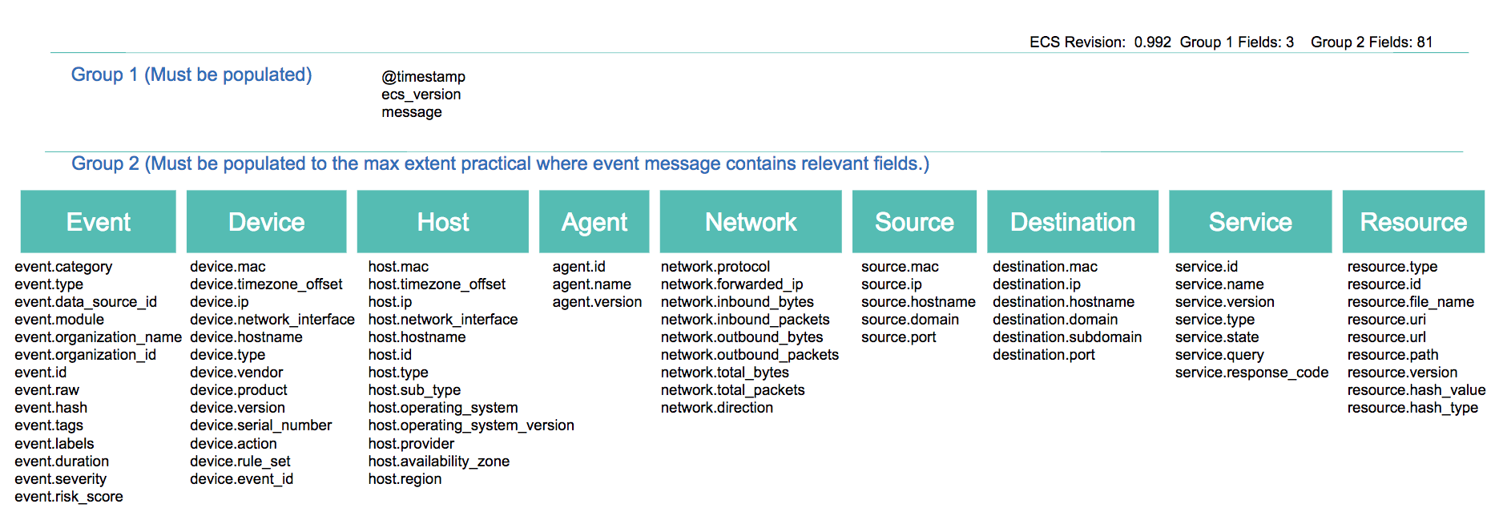
Correlation between logs, metrics, and APM
Elastic Common Schema
Benefits
Status
Correlate data from different sources
Ability to re-use analysis content
Ability to re-use Elastic-provided content
Version v1.0.0 published: github.com/elastic/ecs
Working to integrate into our products
Community feedback welcome!

Slide 14
Sending metrics

Slide 15








Elastic Stack
Beats
Lightweight Data Shippers
winlogbeat
windows event logs
heartbeat
uptime polling
packetbeat
network/protocol
metricbeat
system/app metrics
functionbeat
container metrics
filebeat
log files
auditbeat
linux audit Info

Slide 16
Elastic APM

Slide 17
Evolution of Elastic Stack to an Open Source APM
2017
Elastic joins forces with Opbeat
A next-generation APM solution designed for developers
6.1
Elastic APM beta release
Including APM Server and curated APM UI native to Kibana
6.2
Elastic APM GA
Agents for Python, Node.js, Ruby, Javascript; Real User Monitoring
6.4
Search for APM + more agents
Enabled search & Machine Learning for APM, Java agents GA, RUM GA
6.6
Distributed tracing + Java & Go agents
Support for open tracing enabled with Distributed tracing, added Go Agent, integrated UI with Logs & Metrics
Notes:
Some of the fastest investment we have made has been in the development of Elastic Open Source APM when we joined forces with OpBeat
First we delivered the self managed version with the 6.2 beta release.
Here are the quick hits on our APM story. But we continue to invest heavily in this solution area.
Search Elastic APM beta - python & nodeJS
GA with those
Ruby Agent added
Java Agent added
GoAgent
RUM added
Distributed Tracing Beta 6.5
Integrated search
You can have your own metadata
6.6 integrations with ML / Alerting

Slide 18

What happens between the log entries?
08:32:10 Request comes in "/api/checkout"
Black box
08.33:27 Response goes back "/api/checkout 500 ERROR"

Slide 19
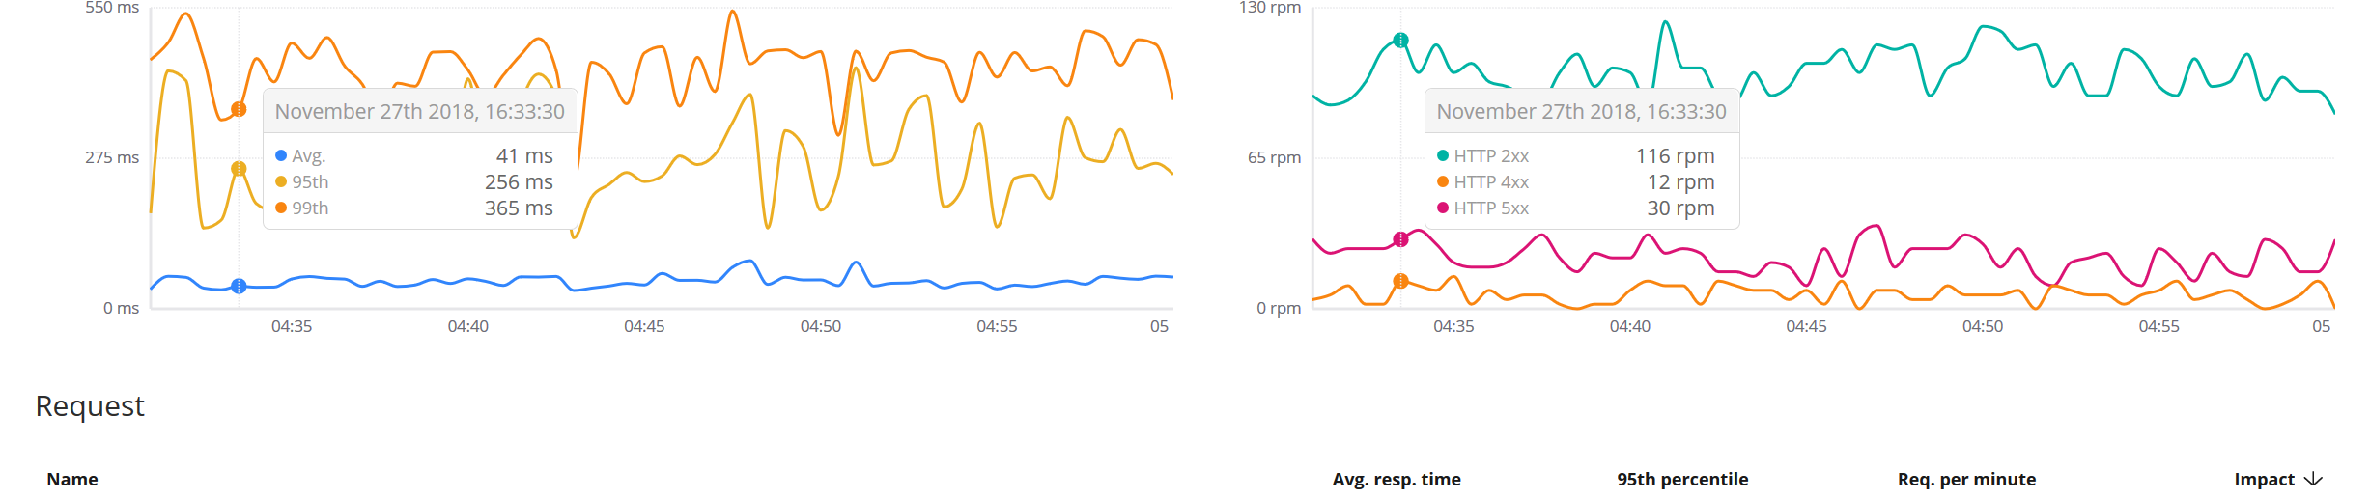
What happens between the log entries?
APM agents live inside the application code
08:32:10 Request comes in "/api/checkout"
08.33:27 Response goes back "/api/checkout 500 ERROR"

Slide 20




Application Metric Collection - Beats
Elasticsearch
Kibana
Beats
Logstash
Notes:
Beats collecting machine metrics and logs, write to Elasticsearch or Logstash
Setup: Install a library, add some config, and introduce the measurement calls in your code.
APM-SERVER will scale just like logstash scales. Put a load balancer in front of it

Slide 21

Application Metric Collection with Elastic APM
Elasticsearch
Kibana
Beats
Logstash
apm-agents
NodeJS
Python
Java
Go
apm-server
Ruby
RUM
Notes:
Support for NodeJS and Python
Setup: Install a library, add some config, and introduce the measurement calls in your code.
APM-SERVER will scale just like logstash scales. Put a load balancer in front of it

Slide 22
Agents
apm-agents
Live in the monitored application process
Are language- and often framework-specific
Collect performance data and errors
Regularly send collected data to APM Server
Ideally have little to no overhead
NodeJS
Python
Java
Go
Ruby
RUM
And .NET!!
Notes:
Support for NodeJS and Python
Setup: Install a library, add some config, and introduce the measurement calls in your code.
APM-SERVER will scale just like logstash scales. Put a load balancer in front of it

Slide 23
What kind of data do agents collect?
apm-agents
Agents are tracers, not profilers
trace only operations that are known to be slow
Things like SQL queries, HTTP requests
in other words: operations that involve I/O
Every traced operation is a span
A group of spans that represent a unit of work is a transaction
Contextual data is collected for both spans and transactions
SQL query for a database span
URL of request for an outgoing HTTP span
request/response data for a HTTP transaction
… and more
NodeJS
Python
Java
Go
Ruby
RUM
And .NET!!
Notes:
Support for NodeJS and Python
Setup: Install a library, add some config, and introduce the measurement calls in your code.
APM-SERVER will scale just like logstash scales. Put a load balancer in front of it

Slide 24
How do agents work?
apm-agents
Different from language to language, but generally...
agents wrap operations in standard library and well-known 3rd party libraries
measure time spent in those operations
collect additional data about the operation
hook into language/framework to detect start/end of request, and capture errors
NodeJS
Python
Java
Go
Ruby
RUM
And .NET!!
Example: https://www.elastic.co/blog/creating-custom-framework-integrations-with-the-elastic-apm-python-agent
Notes:
Support for NodeJS and Python
Setup: Install a library, add some config, and introduce the measurement calls in your code.
APM-SERVER will scale just like logstash scales. Put a load balancer in front of it

Slide 25
How do agents work? - .NET
apm-agents
DiagnosticSource
Rely on events sent by the framework
NodeJS
Python
Java
Go
public static void Subscribe() =>
DiagnosticListener
.AllListeners
.Subscribe(new DiagnosticInitializer());
Ruby
RUM
And .NET!!
internal class DiagnosticInitializer : IObserver<DiagnosticListener>
{
public void OnCompleted() {}
public void OnError(Exception error) {}
public void OnNext(DiagnosticListener value)
{
if (value.Name == "HttpHandlerDiagnosticListener")
value.Subscribe(new HttpHandlerDiagnosticListener());
}
}
Notes:
Support for NodeJS and Python
Setup: Install a library, add some config, and introduce the measurement calls in your code.
APM-SERVER will scale just like logstash scales. Put a load balancer in front of it

Slide 26
How do agents work? - .NET
internal class HttpHandlerDiagnosticListener : IObserver<KeyValuePair<string, object>>
{
public void OnCompleted(){}
public void OnError(Exception error){}
public void OnNext(KeyValuePair<string, object> kv)
{
if (!(kv.Value.GetType().GetTypeInfo().GetDeclaredProperty(“Request")?.GetValue(kv.Value)
is HttpRequestMessage request)) return;
switch (kv.Key)
{
case "System.Net.Http.HttpRequestOut.Start":
break;
case "System.Net.Http.HttpRequestOut.Stop":
var response =
kv.Value.GetType().GetTypeInfo().GetDeclaredProperty(“Response")
.GetValue(kv.Value) as HttpResponseMessage;
break;
}
}
}
Notes:
Support for NodeJS and Python
Setup: Install a library, add some config, and introduce the measurement calls in your code.
APM-SERVER will scale just like logstash scales. Put a load balancer in front of it

Slide 27
APM Server
Is its own process
either deployed on app server, or on separate server(s)
Written in Go, using the Beats framework
Exposes an HTTP API to agents
Optionally provides authentication via token, rate limiting
Transforms and enriches data from agents, writes to Elasticsearch
apm-server
Notes:
Support for NodeJS and Python
Setup: Install a library, add some config, and introduce the measurement calls in your code.
APM-SERVER will scale just like logstash scales. Put a load balancer in front of it

Slide 28
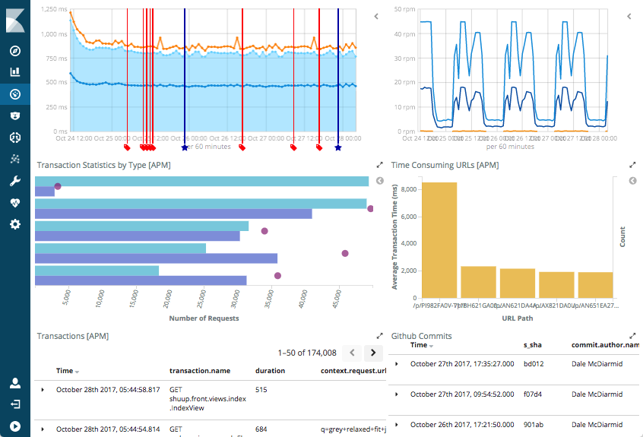
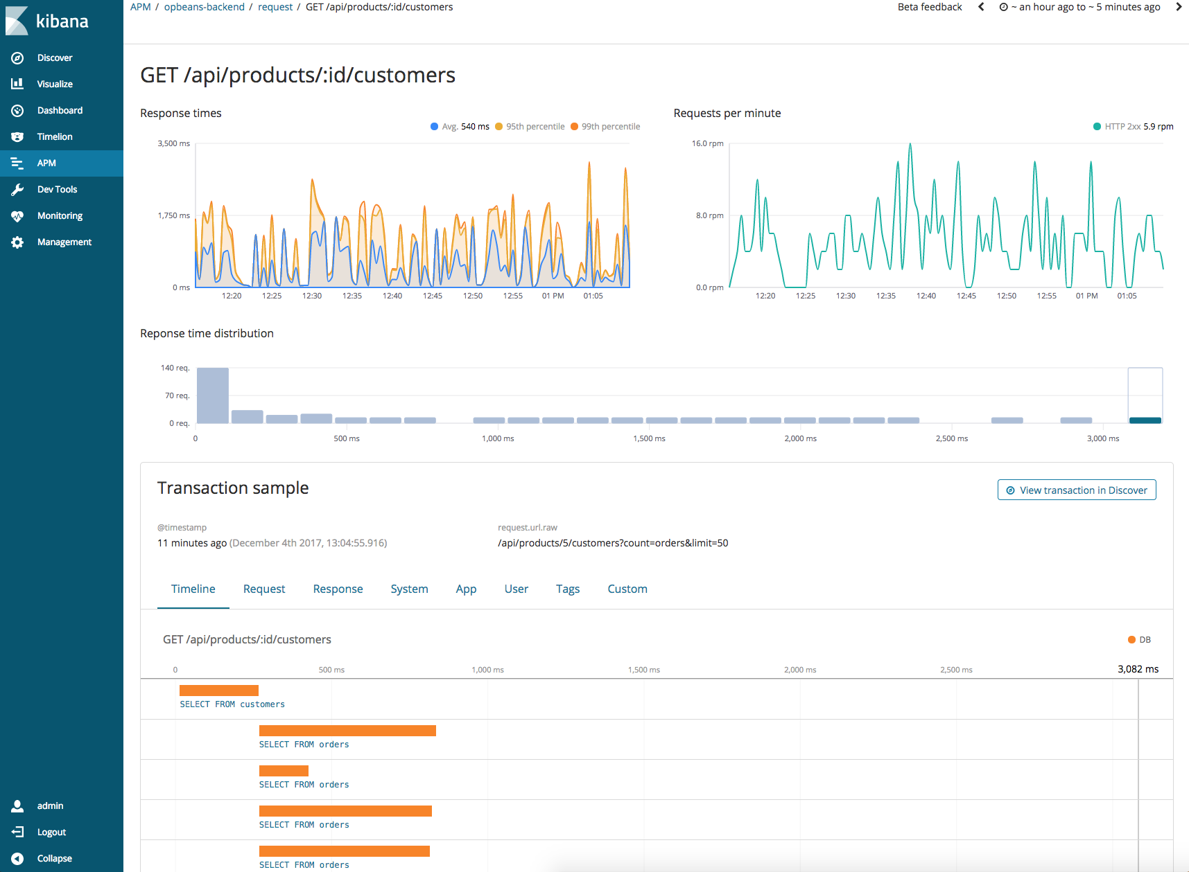
Visualize and analyze in Kibana
Use dashboards or dedicated APM UI
Kibana
Notes:
Support for NodeJS and Python
Setup: Install a library, add some config, and introduce the measurement calls in your code.
APM-SERVER will scale just like logstash scales. Put a load balancer in front of it

Slide 29
It’s just another index!
Search and aggregate
detect anomalies with Machine Learning
trigger alerts using Alerting
Correlate with other indices like database logs, authentication audit logs
With ECS (Elastic Common Schema), this is even more powerful!

Slide 30
Distributed tracing!

Slide 31
Distributed tracing
What is it, and how does it work?

Slide 32
Traditional monolithic app
Monolith
ES

Slide 33
Traditional monolithic app, ca. 2018
React
Monolith
ES

Slide 34
Microservice Architecture
React
ES

Slide 35
Microservice Architecture
React
ES

Slide 36
Microservice Architecture
React
ES

Slide 37
Microservice Architecture
React
ES

Slide 38
Microservice Architecture
React
ES

Slide 39
Distributed tracing
Incoming HTTP request
Backend services
Trace A
POST /checkout
Span
Span
Span
GET auth:/user
Response served
Span
POST billing:/charge
Span
Span

Slide 40
How does distributed tracing work?
Propagating HTTP headers
APM agents creates and propagates unique trace ids via HTTP headers
W3C Trace Context working group is standardizing the HTTP header format for distributed tracing
traceparent: 00- 0af7651916cd43dd8448eb211c80319c- b7ad6b7169203331- 01
// version // trace id
// parent span id // flags (sampling)

Slide 41
Custom instrumentation? Public Agent API
APM Agents try to capture every relevant part of the application (Autoinstrumentation) - e.g. DB calls, HTTP calls, etc.
Users can also manually capture thing - in other words: users can manually create transactions and spans
In .NET:
Agent.Tracer.CurrentTransaction.CaptureSpan("ReadCurrencyRate", "CacheRead", (span) => { //Code to capture as a span
});

Slide 42
Demo
Public agent api

Slide 43
Summary
Observability: Logs + Metrics + Traces/APM Data
Advantage of doing Observability with the Elastic stack: Jump from between those 3

Slide 44
Contact/Links
Twitter: @gregkalapos (DMs are open) (http://twitter.com/gregkalapos)
General questions to Elastic + APM: https://discuss.elastic.co/c/apm
Elastic APM GitHub Repo (general issues): https://github.com/elastic/apm https://github.com/elastic/apm-contrib
.NET Agent GitHub Repo: https://github.com/elastic/apm-agent-dotnet

